Slide 1
Circuit Switching
It is a type of switching in which dedicated channel or circuit is established for the duration of communications.
Dedicated Path
Fixed bandwidth
It used multiplexing techniques such as
FDM (Frequency Division Multiplexing) and
TDM (Time Division Multiplexing).
When connection is established, the n/w dedicates one time slot in every frame to this connection.

Slide 2
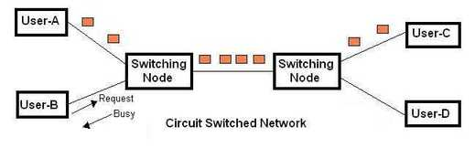
For TDM,
Transmission rate = Frame rate * number of bits in a slot
If link transmits 8000 frames per second and each slot consist of 8 bits then
Transmission rate = 8000*8 = 64000 bps = 64kbps

Slide 3
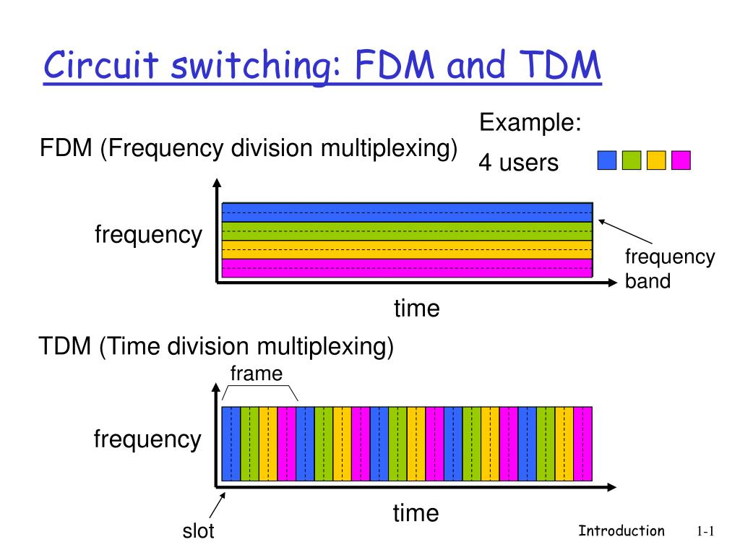

Slide 4
Packet Switching
Long messages divided into smaller chunks and its travel through packet switches.
It provide storage facility.
It store the data and then forward transmission.
Each packet switch has an output buffer, which stores packet that router is about to send.
If there is congestion (traffic) or network busy issue occurred then packet should must have to wait in buffer and this process of waiting is known as “Queuing Delay”.

Slide 5
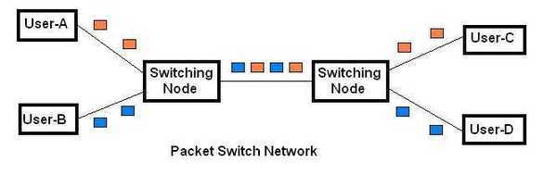
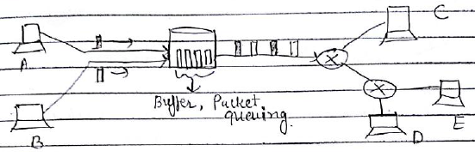
If buffer is full then arrived packet or queued packet will be dropped and packet loss will be occur.

Slide 6
